Slide 1

Sample 1
WHY MLOPS? – A COHESIVE ENVIRONMENT THAT ENABLES…
MACHINE LEARNING
DATA ACQUISITION
BUSINESS UNDERSTANDING
MACHINE LEARNING METHODOLOGIES
MACHINE LEARNING • DEVELOPMENT • OPERATIONS
DEVELOPMENT
CONTINUOUS INTEGRATION
MODELING + TESTING
DEPLOYMENT EFFICIENCY
OPERATIONS
CONTINUOUS DELIVERY
DATA FEEDBACK LOOP
MODEL MONITORING

Slide 2
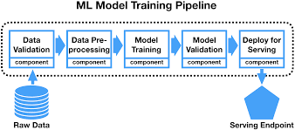
Machine Learning Sample Pipeline FLOW
Data Preprocessing includes:
Missing Value Imputation
Normalization
Feature Engineering

Slide 3

Sample 1
DEMO: PREDICTING TAXI CAB TRIP TIME…
Recalibrating models in real time with the most up to date data helps us to identify estimated trip times and increases overall productivity and efficiency for the business.
Data Fetch Queries
Tensorflow ML Models
Kubeflow Pipelines
Reports
Scripts and procedures enables to fetch data at any set interval for extraction of the training and validation data sets
Drop zones for data input and output
Model development environment on GCP using JupyterHub.
Demo Tensorflow model developed to predict trip time on the onset of the trip
ML pipeline to generate models.
Triggers established for model recalibration
Delivery of model results and scoring set for batch or continuous delivery
Model retriggering events initiate new model estimates and reports on accuracy of the model and the cost/benefit analysis for the org.

Slide 4
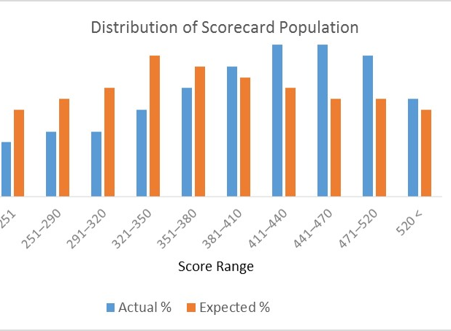
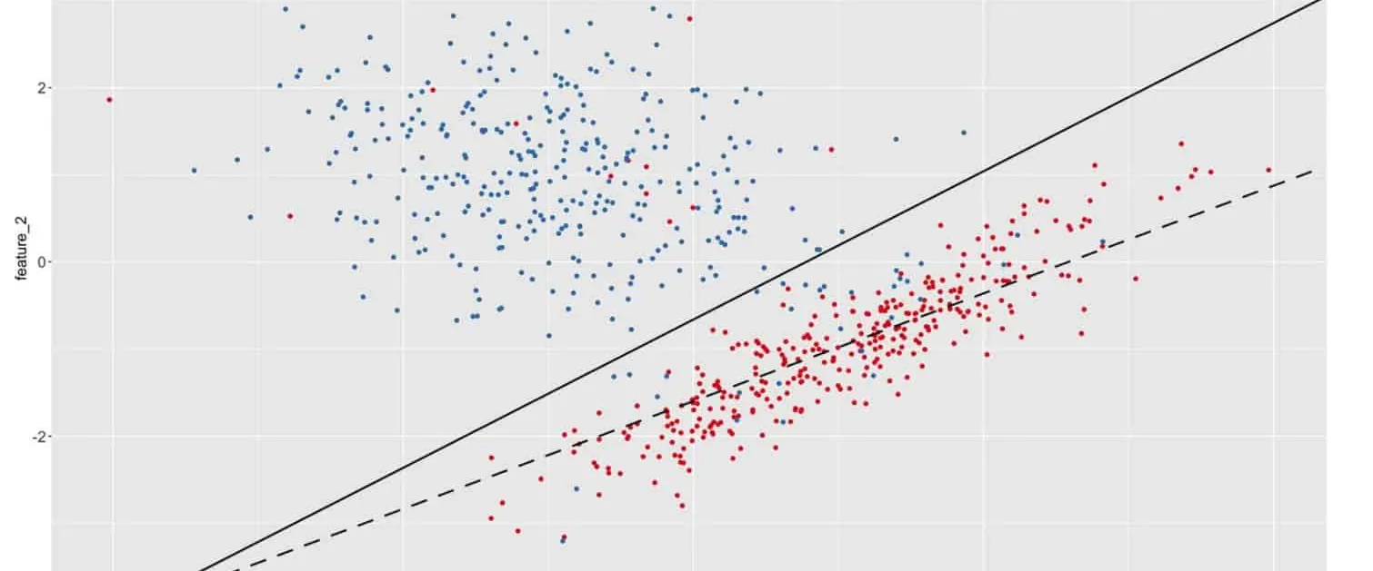

UNDERSTANDING DRIFT
In Big Data Environments, monitoring data population changes are essential
for model accuracy and relevancy!

Slide 5




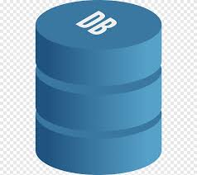

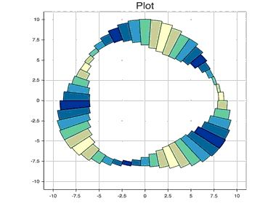
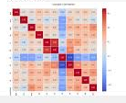
OUR APPROACH
DATA IS CURATED AND COLLECTED FROM A RT SOURCE
REPORTS
Storage
1
KUBEFLOW & KUBERNETES FOR CONTINUOUS DEPLOYMEMT
File Drop
2
File Drop
3
MODEL RESULTS HISTORY SAVED IN DB
DATA SCIENCE AND ML WORKSTATION

Slide 6


DASHBOARDS
MLOPS REPORTS EXAMPLES
STABILITY METRICS & REPORTS
PSI – POPULATION STABILITY INDEX
DIVERGENCE INDEX
PERFORMANCE METRICS & REPORTS
K-S, RMSE, AUC-ROC, R-SQUARED, CONFUSION MATRIX WITH COST
OPERATIONS METRICS & REPORTS
ML AND PIPELINE HEALTH

Slide 7
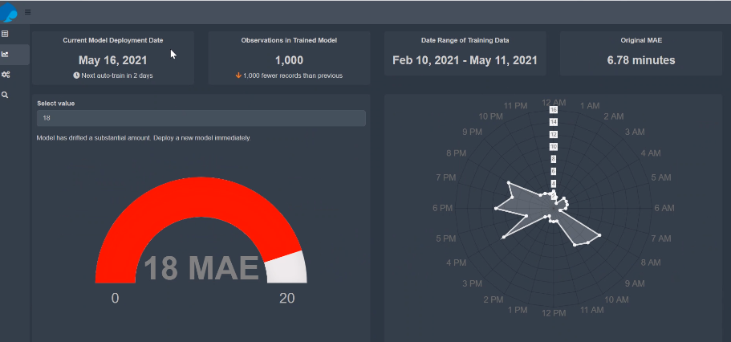
DEMO – MONITORING DRIFT AND MODEL PERFORMANCE

